Slide 1
Parallel
Prefix-Sum using OpenMP
CS-301 : High Performance Computing
Raj Patel(201701422)
Shubh Desai(201701466)
Assigned by :-
Prof. Bhaskar Chaudhury

Slide 2
Serial Algorithm and Complexity Analysis
n = Problem-Size
Sum = 0
for i = 1 to n do
sum = sum + X[i]
X[i] = Sum
end for
Since each of the array element is accessed once, the complexity of this Serial Algorithm is O(n).

Slide 3
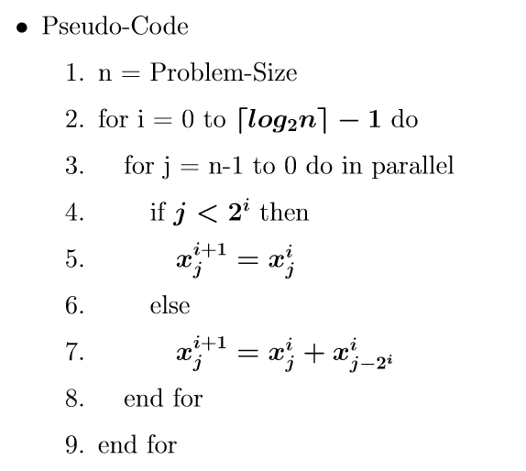
Parallel Strategy - I (O(n * log n/m))

Slide 4
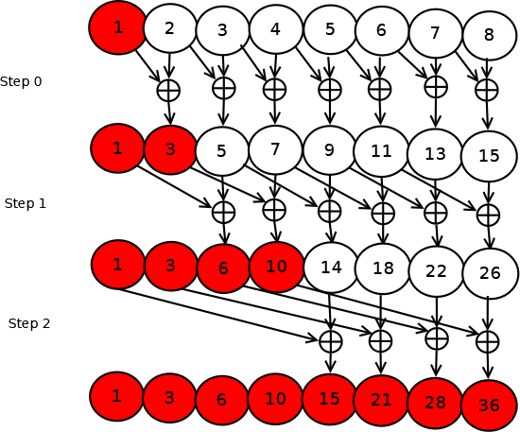
Parallel Strategy - I (Pictorial Representation)

Slide 5
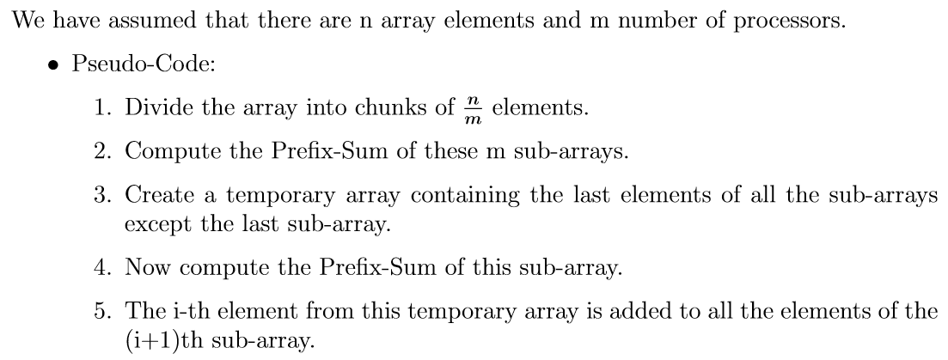
Parallel Strategy- II ( O(2n/m) )

Slide 6
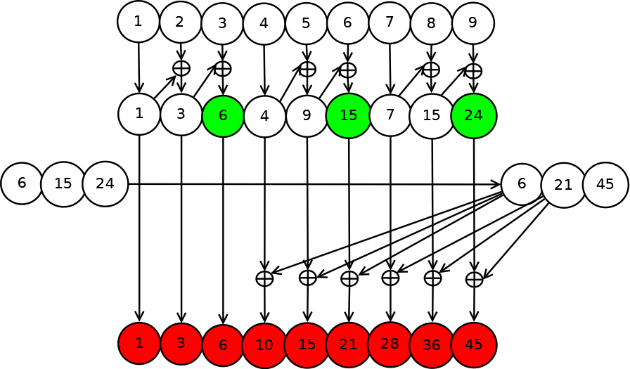
Parallel Strategy - II (Pictorial Representation) (N = 9, M = 3)

Slide 7
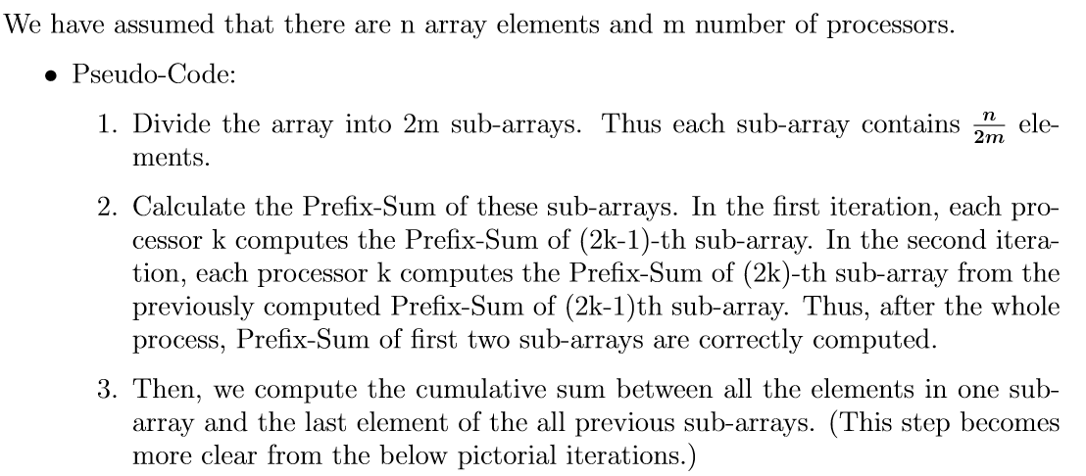
Parallel Strategy - III ( O(2n + (n * log m)) / m)

Slide 8
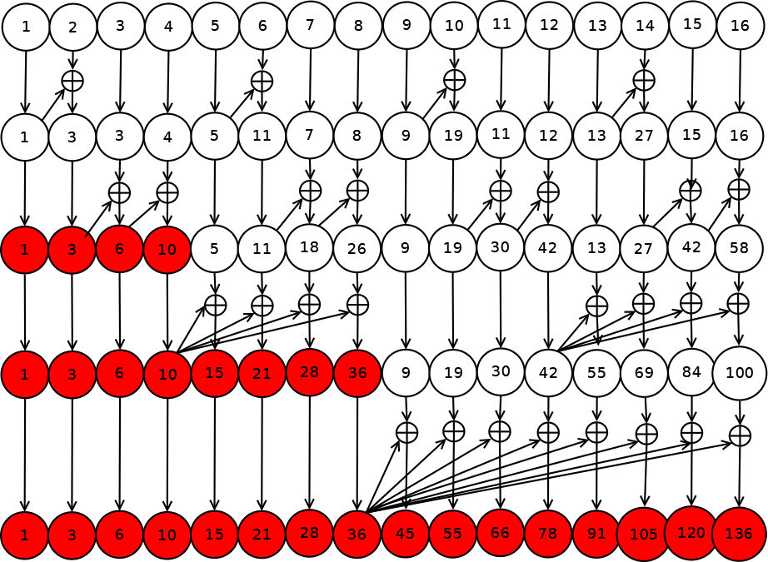
Parallel Strategy - III(Pictorial Representation) (N = 16, M = 4))

Slide 9
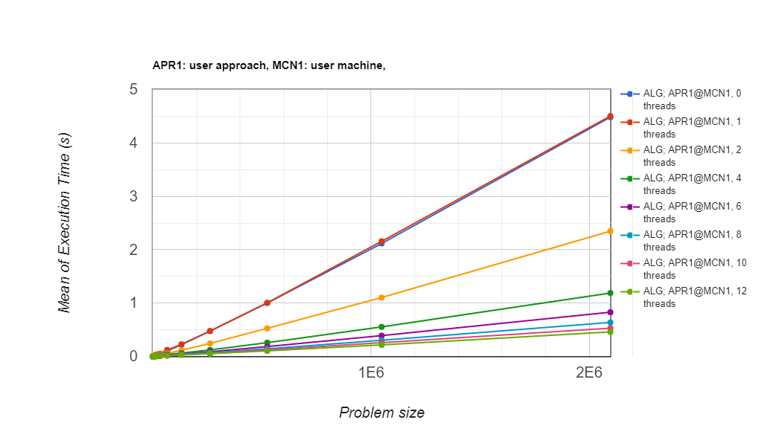
Execution Time vs. Problem Size(Strategy-I)

Slide 10
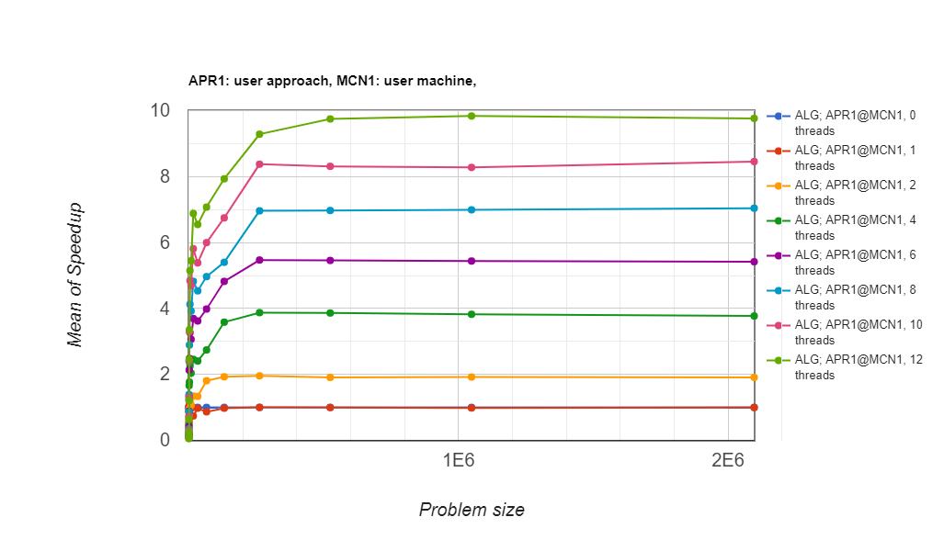
Speedup(Strategy-I)

Slide 11
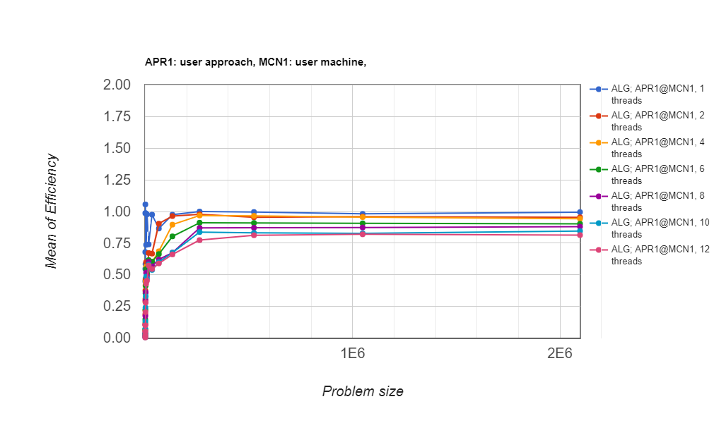
Efficiency(Strategy-I)

Slide 12
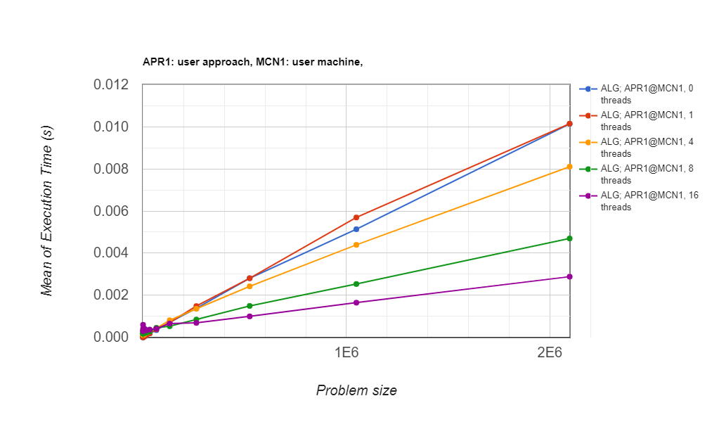
Execution Time vs. Problem Size(Strategy-II)

Slide 13
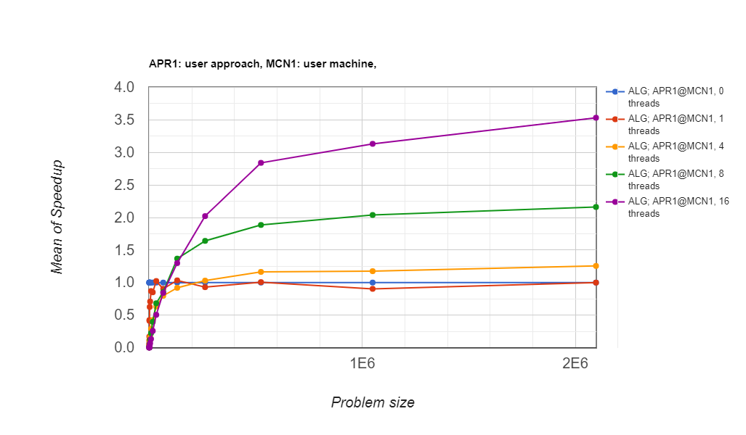
Speedup(Strategy-II)

Slide 14
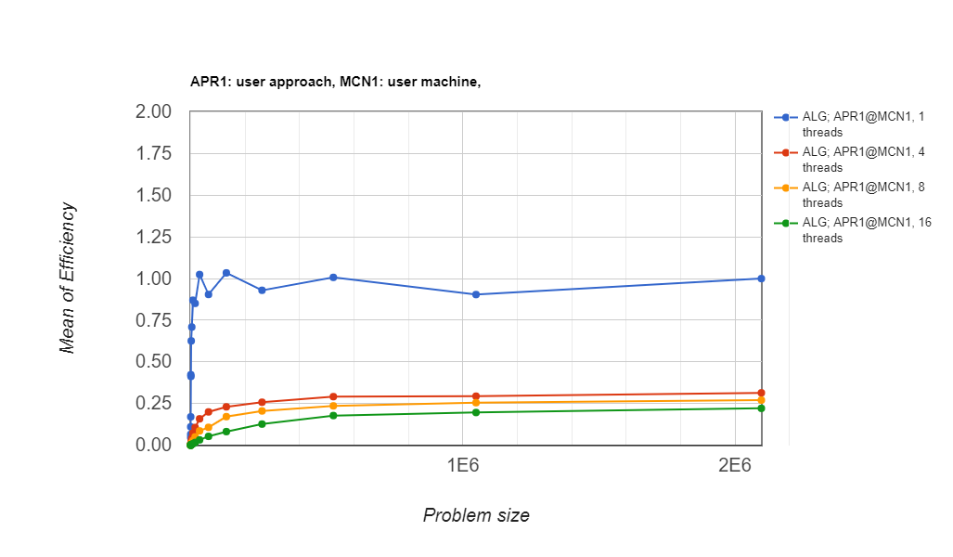
Efficiency(Strategy-II)

